Slide 1





Green Cycle Movie Rental Analysis
By using PostgreSQL

Slide 2


1
2
3
We are using a database which is present in green cycle database repository.
We are using PostgreSQL in this project. And solved problems using SQL queries
We have covered major practical questions and we have also given the solution with query.

Slide 3


Tools used
pgAdmin
1
PostgreSQL
2
Green Cycle Database
3

Slide 4










Green Cycle
Rental Store

Slide 5



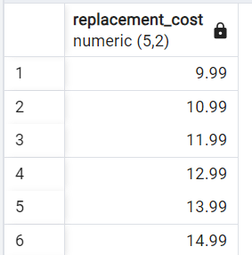

Task: Create a list of all the different (distinct) replacement costs of the films.
SELECT DISTINCT (replacement_cost)
FROM film
ORDER BY replacement_cost

Slide 6

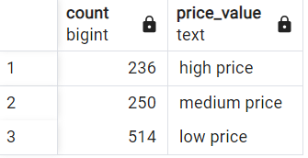
Task: Write a query that gives an overview of how many films have replacements costs in the following cost ranges
low: 9.99 - 19.99
medium: 20.00 - 24.99
high: 25.00 - 29.99
SELECT
COUNT(*) AS count,
CASE
WHEN replacement_cost > 25.00 THEN 'high price'
WHEN replacement_cost > 20.00 THEN 'medium price'
ELSE 'low price'
END AS price_value
FROM
film
GROUP BY
price_value;

Slide 7

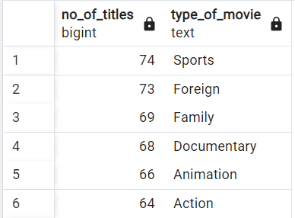
Task: Create an overview of how many movies (titles) there are in each category (name).
select count(f.title) as no_of_titles, c.name as type_of_movie from category c
inner join film_category fc
on fc.category_id = c.category_id
inner join film f
on f.film_id = fc.film_id
group by c.name
order by no_of_titles desc

Slide 8
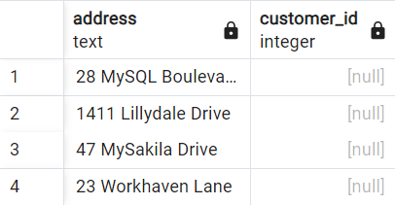
Task: Create an overview of the addresses that are not associated to any customer.
select address, customer_id from address a
left join customer c
on a.address_id = c.address_id
where customer_id is null

Slide 9
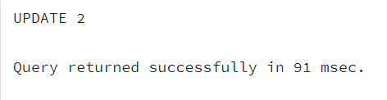
Rename the position title from Customer Support to Customer Specialist.
UPDATE employ
SET position_title='Customer Specialist'
WHERE position_title='Customer Support';

Slide 10

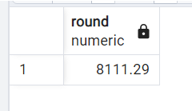
Calculate the average salary of SQL Analysts.
SELECT ROUND(AVG(salary),2)
FROM employees
WHERE position_title='SQL Analyst'

Slide 11
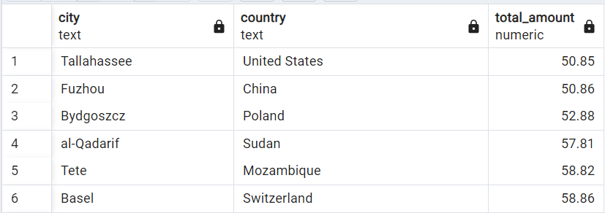
Task: Create an overview of the revenue (sum of amount) grouped by a column in the format "country, city".
select ci.city, co.country, sum(p.amount) as total_amount from address a
left join customer c
on a.address_id = c.address_id
inner join city ci
on ci.city_id = a.city_id
inner join payment p
on p.customer_id = c.customer_id
inner join country co
on co.country_id = ci.country_id
group by ci.city, co.country
order by total_amount

Slide 12

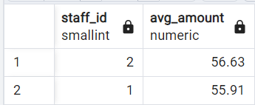
Task: Create a list with the average of the sales amount each staff_id has per customer.
select
staff_id,
round(avg(amount),2) as avg_amount
from (select sum(amount) as amount, staff_id, customer_id from payment
group by staff_id, customer_id )
group by staff_id
order by avg_amount desc

Slide 13
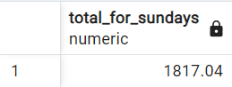
Task: Create a query that shows average daily revenue of all Sundays.
select
round(avg(t_amount),2) as total_for_sundays
from
(select extract (dow from payment_date) as day_of_week, date(payment_date), sum(amount) as t_amount from payment
where extract (dow from payment_date) = '0'
group by day_of_week, date(payment_date) )

Slide 14
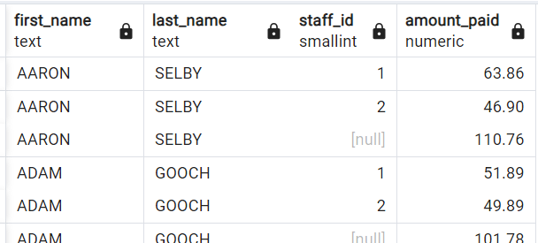
Write a query that return the sum of the amount for each customer (first name and last name) and each staff_id. Also add the overall revenue per customer.
SELECT c.first_name,
c.last_name,
p1.staff_id,
sum(amount) as amount_paid
FROM payment p1
INNER JOIN customer c
ON c.customer_id = p1.customer_id
GROUP BY
(c.first_name), (c.last_name),
GROUPING SETS ((p1.staff_id),(c.first_name))
ORDER BY 1,2,3

Slide 15
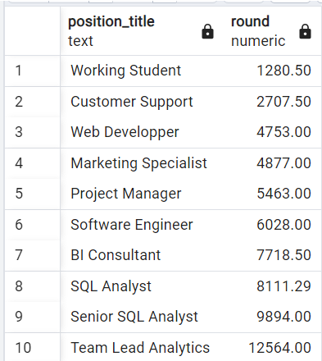
Return the average salaries for each position with appropriate rounding.
SELECT
position_title,
ROUND(AVG(salary),2)
FROM v_employees_info
GROUP BY position_title
ORDER BY 2;

Slide 16
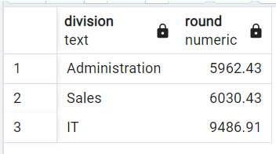
Return the average salaries per division.
SELECT
division,
ROUND(AVG(salary),2)
FROM employees e
LEFT JOIN departments d
ON e.department_id=d.department_id
GROUP BY division
ORDER BY 2

Slide 17
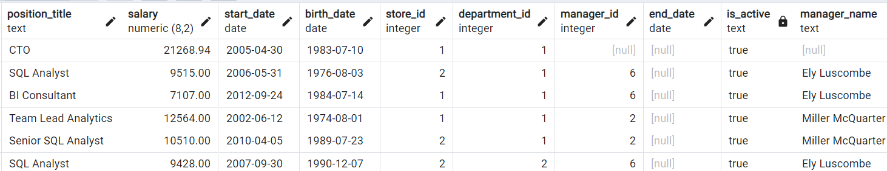
Write a query to add columns manager and is_active.
SELECT
emp.*,
CASE WHEN emp.end_date IS NULL THEN 'true'
ELSE 'false'
END as is_active,
mng.first_name ||' '|| mng.last_name AS manager_name
FROM employees emp
LEFT JOIN employees mng
ON emp.manager_id=mng.emp_id;

Slide 18
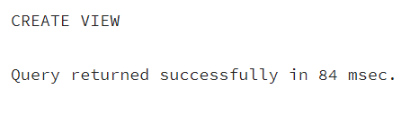
Create a view v_employees_info
CREATE VIEW v_employees_info
AS
SELECT
emp.*,
CASE WHEN emp.end_date IS NULL THEN 'true'
ELSE 'false'
END as is_active,
mng.first_name ||' '|| mng.last_name AS manager_name
FROM employees emp
LEFT JOIN employees mng
ON emp.manager_id=mng.emp_id;

Slide 19
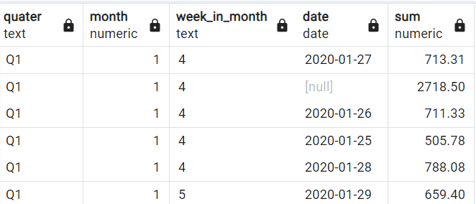
Write a query that calculates amount rollup for the hierarchy of quarter, month, week in month and day.
select
'Q' || TO_CHAR(payment_date, 'Q') as quater,
extract (month from payment_date) as month,
TO_CHAR(payment_date, 'W') as week_in_month,
date(payment_date),
sum(amount)
from payment
group by
rollup(
'Q' || TO_CHAR(payment_date, 'Q'),
extract (month from payment_date),
TO_CHAR(payment_date, 'W'),
date(payment_date)
)
order by 1,2,3

Slide 20
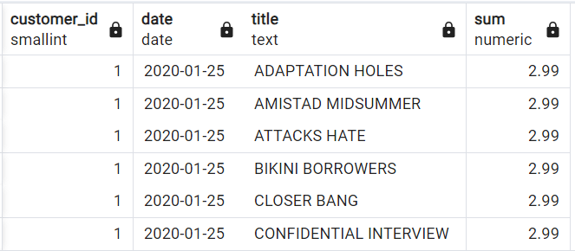
Write a query that returns all grouping sets in all combinations of customer_id, date and title with the aggregation of the payment amount.
select p.customer_id,
date(payment_date),
title,
sum(amount)
from payment p
inner join rental r
on r.customer_id = p.customer_id
inner join inventory i
on i.inventory_id = r.inventory_id
inner join film f
on f.film_id = i.film_id
group by
cube(
p.customer_id,
date(payment_date),
title
)
order by 1,2,3

Slide 21
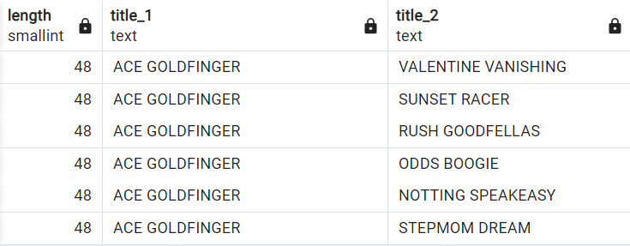
Find all the pairs of films with the same length!
select
f1.length,
f1.title as title_1,
f2.title as title_2
from film f1
left join film f2
on f1.length = f2.length
where f1.title != f2.title

Slide 22
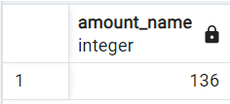
Create a function that expects the customer's first and last name and returns the total amount of payments this customer has made.
Create or replace function amount_name (first_n varchar(20) ,last_n varchar(20))
returns INT
language plpgsql
AS
$$
declare
sum_amount INT;
begin
select sum(p.amount)
into sum_amount
from customer c
inner join payment p
on p.customer_id = c.customer_id
where c.first_name = first_n
and c.last_name = last_n;
return sum_amount;
end;
$$;
Calling the FUNCTION:
SELECT amount_name ('LINDA','WILLIAMS');

Slide 23
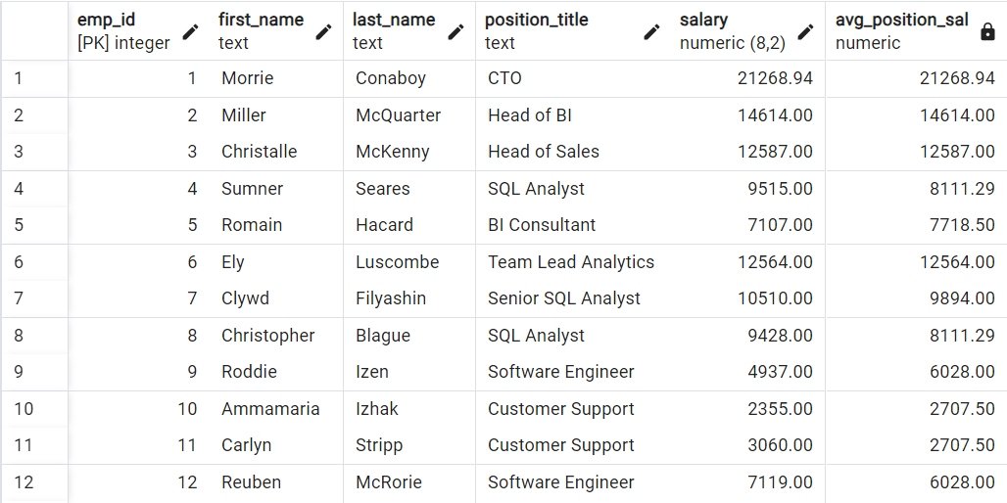
Write a query to return employee details and average salary for each job position.
SELECT
emp_id,
first_name,
last_name,
position_title,
salary,
ROUND(AVG(salary) OVER(PARTITION BY position_title),2) as avg_position_sal
FROM employees
ORDER BY 1;

Slide 24
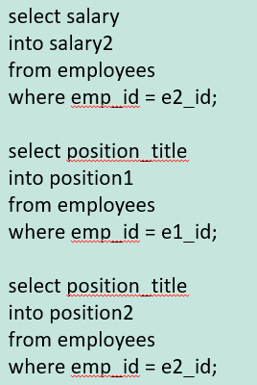
Create a stored procedure called emp_swap that accepts two parameters emp1 and emp2 as input and swaps the two employees' position and salary. Test the stored procedure with emp_id 2 and 3. Below table is for reference
create procedure swap_post (e1_id INT, e2_id INT)
LANGUAGE plpgsql
AS
$$
declare
-- Delcaring variables
salary1 decimal(8,2);
salary2 decimal(8,2);
position1 text;
position2 text;
begin
-- Assigning values to variables
select salary
into salary1
from employees
where emp_id = e1_id;

Slide 25
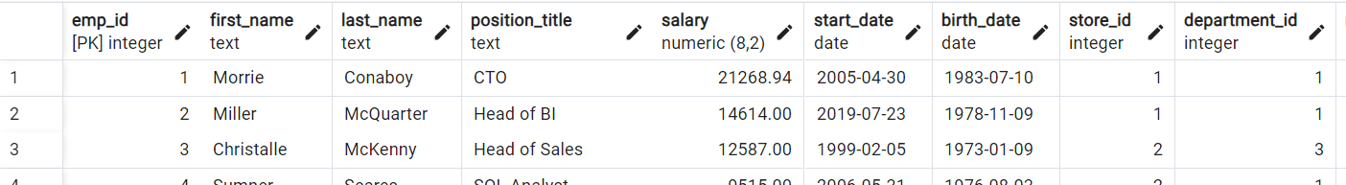
The two employees Miller McQuarter and Christalle McKenny have agreed to swap their positions incl. their salary.
select * from employees
begin;
update employees
set position_title = 'Head of BI'
where emp_id =1;
update employees
set position_title = 'CTO'
where emp_id =2;
update employees
set salary = 21268.94
where emp_id =2;
update employees
set salary = 14614.00
where emp_id = 1;
commit;

Slide 26
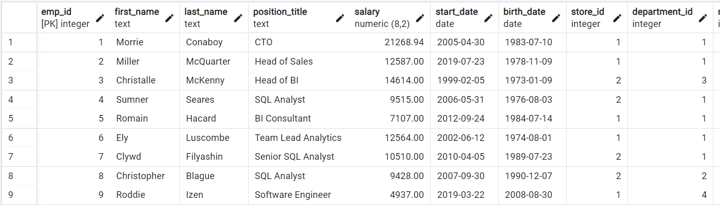
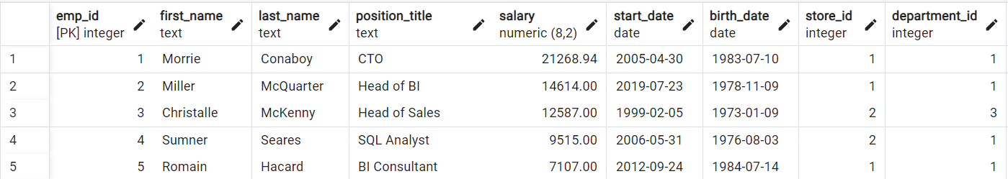
-- Updating the SWAP values
update employees
set position_title = position1
where emp_id = e2_id;
update employees
set position_title = position2
where emp_id = e1_id;
update employees
set salary = salary1
where emp_id = e2_id;
update employees
set salary = salary2
where emp_id = e1_id;
commit;
end;
$$
call swap_post(2,3)
select * from employees
order by emp_id
Before and After executing the query the table is

Slide 27
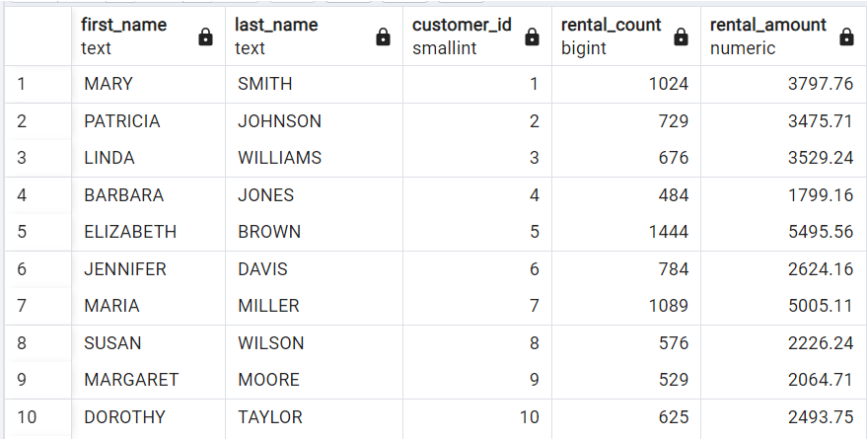
Create a CTE to calculate the total rental count and total rental amount for each customer.
with rental_payment_cte as(
select c.first_name,
c.last_name,
r.customer_id,
count(r.rental_id) as rental_count,
sum(p.amount) as rental_amount
from rental r
inner join payment p
on p.customer_id = r.customer_id
inner join customer c
on c.customer_id = p.customer_id
group by r.customer_id,c.first_name, c.last_name)
select first_name,
last_name,
customer_id,
rental_count,
rental_amount
from rental_payment_cte

Slide 28
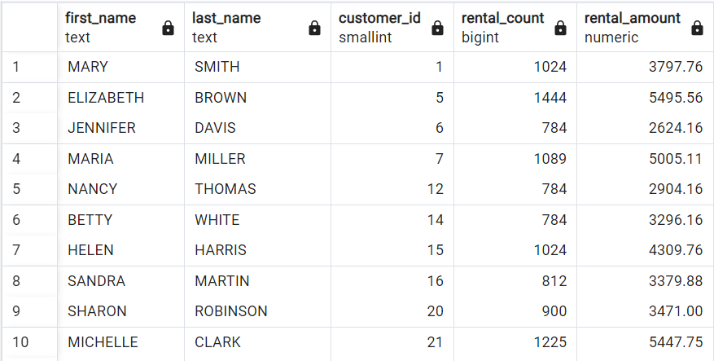
Use the CTE to filter customers who have rented more than the average number of films.
with rental_payment_cte as(
select c.first_name,
c.last_name,
r.customer_id,
count(r.rental_id) as rental_count,
sum(p.amount) as rental_amount
from rental r
inner join payment p
on p.customer_id = r.customer_id
inner join customer c
on c.customer_id = p.customer_id
group by r.customer_id,c.first_name, c.last_name)
select first_name,
last_name,
customer_id,
rental_count,
rental_amount
from rental_payment_cte
where rental_count >
(select round(avg(rental_count),2)
from rental_payment_cte)

Slide 29
List the details of the films rented by these high-rental customers.
with rental_payment_cte as(
select c.first_name,
c.last_name,
r.customer_id,
count(r.rental_id) as rental_count,
sum(p.amount) as rental_amount,
f.title,
f.film_id
from rental r
inner join payment p
on p.customer_id = r.customer_id
inner join customer c
on c.customer_id = p.customer_id
inner join inventory i
on i.inventory_id = r.inventory_id
inner join film f
on f.film_id = i.film_id
group by r.customer_id,c.first_name, c.last_name, f.title, f.film_id)

Slide 30
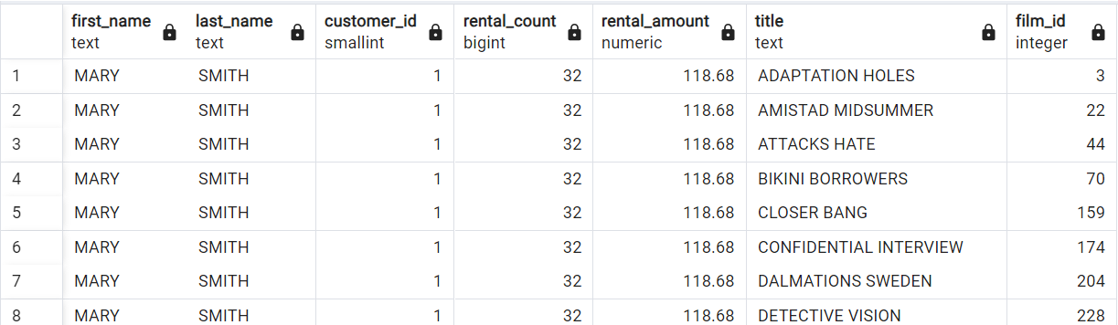
select first_name,
last_name,
customer_id,
rental_count,
rental_amount,
title,
film_id
from rental_payment_cte
where rental_count >
(select round(avg(rental_count),2)
from rental_payment_cte)
After running query the table is

Slide 31
We have created a new tables to modify & improve our skills

Slide 32
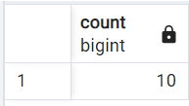
Write a query to count how many people earn less than their average position salary.
SELECT
COUNT(*)
FROM (
SELECT
emp_id,
salary,
ROUND(AVG(salary) OVER(PARTITION BY position_title),2) as avg_pos_sal
FROM employees) a
WHERE salary<avg_pos_sal;

Slide 33
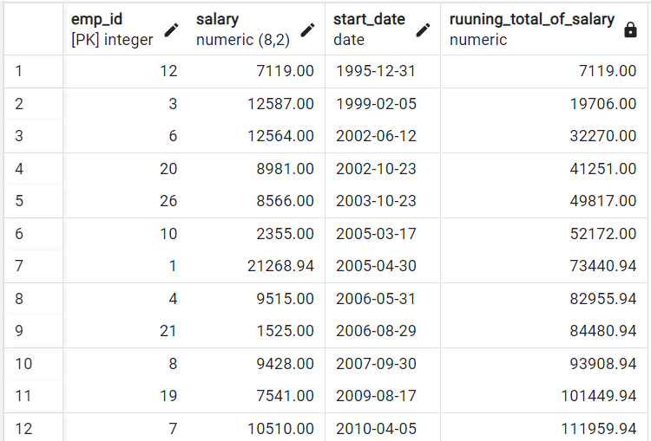
Write a query to return a running total of salary development ordered by start date
SELECT
emp_id,
salary,
start_date,
SUM(salary) OVER(ORDER BY start_date) as ruuning_total_of_salary
FROM employees;

Slide 34
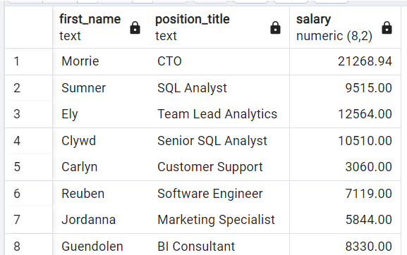
Write a query to output the top earner per position title.
SELECT
first_name,
position_title,
salary
FROM employees e1
WHERE salary = (SELECT MAX(salary)
FROM employees e2
WHERE e1.position_title=e2.position_title)

Slide 35
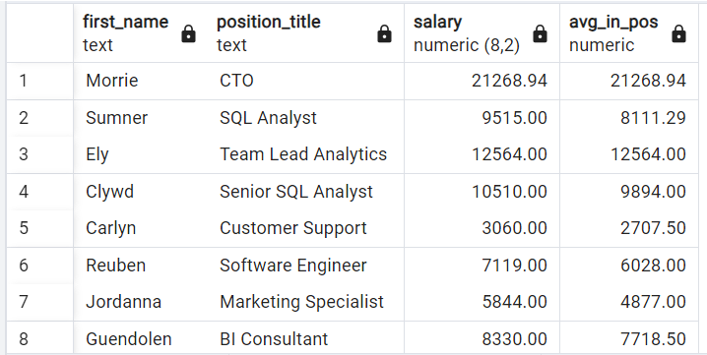
Add the average salary per position title to the previous query.
SELECT
first_name,
position_title,
salary,
(SELECT ROUND(AVG(salary),2) as avg_in_pos
FROM employees e3
WHERE e1.position_title=e3.position_title)
FROM employees e1
WHERE salary = (SELECT MAX(salary)
FROM employees e2
WHERE e1.position_title=e2.position_title)

Slide 36
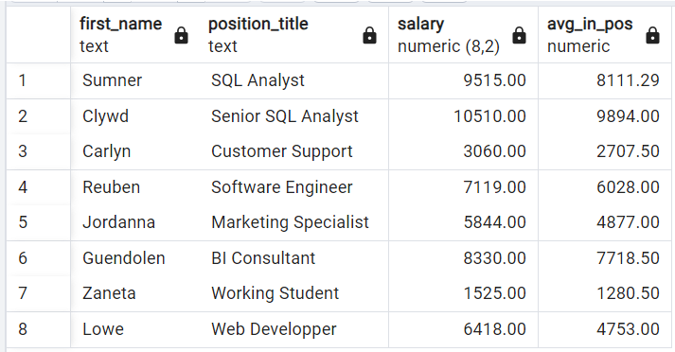
Remove employees from the output who have the same salary as the average of their position title.
SELECT
first_name,
position_title,
salary,
(SELECT ROUND(AVG(salary),2) as avg_in_pos
FROM employees e3
WHERE e1.position_title=e3.position_title)
FROM employees e1
WHERE salary = (SELECT MAX(salary)
FROM employees e2
WHERE e1.position_title=e2.position_title)
AND salary<>(SELECT ROUND(AVG(salary),2) as avg_in_pos FROM employees e3
WHERE e1.position_title=e3.position_title)

Slide 37
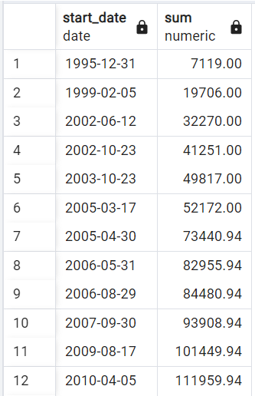
Create a running total considering employees who have left the company.
SELECT
start_date,
SUM(salary) OVER(ORDER BY start_date)
FROM (
SELECT
emp_id,
salary,
start_date
FROM employees
UNION
SELECT
emp_id,
-salary,
end_date
FROM v_employees_info
WHERE is_active ='false'
ORDER BY start_date) a

Slide 38
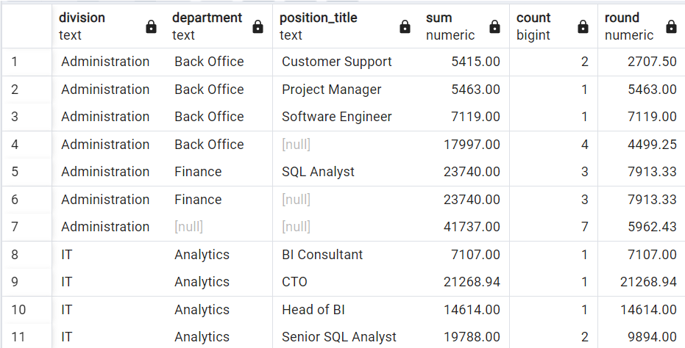
Write a query to return all meaningful aggregations of salary, number of employees, and average salary grouped by division, department, and position title.
SELECT
division,
department,
position_title,
SUM(salary),
COUNT(*),
ROUND(AVG(salary),2) FROM employees
NATURAL JOIN departments
GROUP BY
ROLLUP(
division,
department,
position_title )
ORDER BY 1,2,3

Slide 39
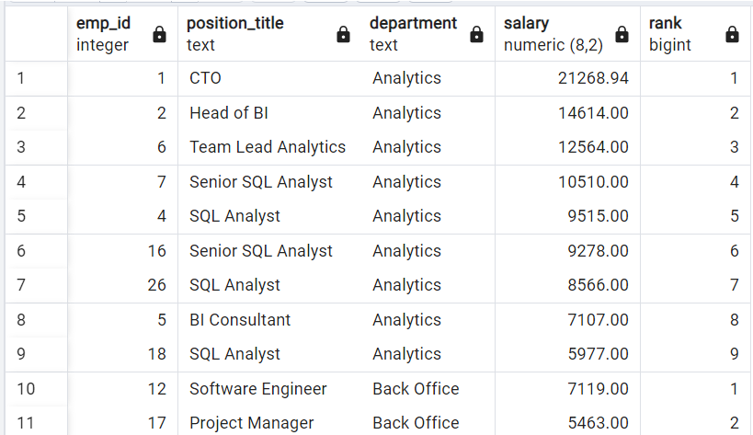
Write a query to return employees’ details and rank their salary partitioned by department.
SELECT
emp_id,
position_title,
department,
salary,
RANK() OVER(PARTITION BY department ORDER BY salary DESC)
FROM employees
NATURAL LEFT JOIN departments

Slide 40
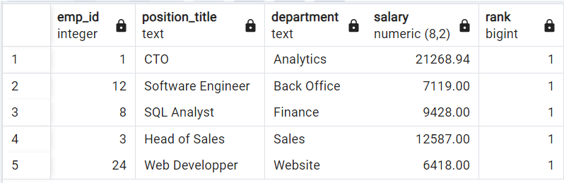
Write a query to return the top earner of each department.
SELECT * FROM
(
SELECT
emp_id,
position_title,
department,
salary,
RANK() OVER(PARTITION BY department ORDER BY salary DESC)
FROM employees
NATURAL LEFT JOIN departments) a
WHERE rank=1

